Slide 1
HR PROJECT

Slide 2
CONTENTS
About the project
A detailed description about the project.
About the Data
Introduction to data set that is been used for project.
Insights to find?
What are the objectives and insights that are to be found out?
1
2
3
Steps for EDA and cleaning data
Various steps used for data cleaning and EDA process.
₅ Visual analytics
Different visuals and summaries to understand data well
Key Findings
Insights we found out according to various questions.
4
6
Dashboard view
The view of dashboard that is been created
7

Slide 3
ABOUT THE PROJECT
1

Slide 4
ABOUT PROJECT
This project focuses on extracting insights from a large dataset related to recruitment and placement activities in companies. The dataset provides valuable information that can be used by the HR department to gain knowledge about the recruitment process and market trends. The project involves several steps, including data scraping, data cleaning, exploratory data analysis (EDA), and building a dashboard using Tableau.

Slide 5
ABOUT THE DATA
2

Slide 6
ABOUT DATA SET
The dataset is about the job details data scraped from LinkedIn. The companies in the dataset are India-based companies. Data consist of job descriptions for various roles like Java Developer, Data analyst, Software Testing and Data Engineer. The Dashboard made at the end is for the HR Team of a company.

Slide 7
DETAILS OF DATASET
1
JOB_ID
Unique Identifier For Each Job Posting.
2
DESIGNATION
The Job Title Column Contains The Name Of The Jobs Given By A Particular Company.
3
COMPANY_ID
Unique Identifier For Each Company.
4
NAME
The Company Name Column Contain The Name Of The Company Offering The Job.
WORK_TYPE
The Column Contains Various The Type Of Work Offered (E.G., Full-time, Part-time, Etc.).
5

Slide 8
DETAILS OF DATASET
6
INVOLVEMENT
The Level Of Involvement Required For The Job (E.G., Full-time, Part-time).
7
EMPLOYEES_COUNT
The Count Of Employees In The Company.
8
TOTAL_APPLICANTS
The Total Number Of Applicants For The Job.
9
LINKEDIN_FOLLOWERS
The Number Of Followers On The Company's Linkedin Page.
10
JOB_DETAILS
Description Of The Job And Its Responsibilities.

Slide 9
DETAILS OF DATASET
11
DETAILS_ID
Unique Identifier For The Job Details.
INDUSTRY
The Industry Or Sector To Which The Company Belongs.
12
13
LEVEL
The Experience Level Or Seniority Associated With The Job.
14
CITY
The City Where The Job Is Located.
15
STATE
The State Where The Job Is Located.

Slide 10
INSIGHTS TO FIND OUT?
3

Slide 11
INSIGHTS TO BE FOUND?
1
What are total number of jobs available?
2
What are total number of companies providing jobs?
3
What are total jobs for various domains?
What are various career level and it’s distribution across various jobs?
4
5
What are distribution of jobs across various analytics fields?

Slide 12
INSIGHTS TO BE FOUND?
6
Which company is providing highest number of jobs?
7
Which domain has the highest number of jobs?
8
Which Industry Having Largest Number Of Linkedin followers
9
What are various job types for different job titles?
10
Which are TOP 5 companies with highest jobs?

Slide 13
STEPS FOR CLEANING DATA AND EDA
4

Slide 14
1. REMOVING UNECESSARY COLUMNS
1
REMOVING THE DUPLICATES
Removing The Duplicate Values From The Dataframe
2
REMOVING ALUMNI COLUMN
Alumni Column Has More Then 40% Null Values And It Is Not Important In Our Analysis
3
REMOVING HIRING_PERSON_LINK COLUMN
hiring_person_link Column Has Not Important In Our Analysis

Slide 15
2. REMOVING NULL VALUES, ERRORS AND SPLITTING
1
REMOVING NULL VALUES AND UNWANTED SRINGS FROM COLUMNS
In This Step, We Address All The Null Values In The Dataframe And Remove Any Unwanted Strings Added To The Dataframe.
2
SPLIT THE NO OF EMPLOYEE AND INDUSTRY DETAILS FROM THE NO_OF_EMPLOY
There is 2 details were stored in the no_of_employ column Count of employee and industry So, make a separate column for each.
3
SPLIT THE INVOLVEMENT AND LEVEL COLUMN FROM THE FULL_TIME_REMOTE
There Is 2 Details Were Stored In The Column Type Of Involvement And Level Of That Job So, Make A Separate Column For Each.
4
SPLIT THE CITY AND STATE COLUMN FROM THE LOCATION COLUMN
In the location column sate and city is stored separate the info into 2 columns

Slide 16
3. CHANGING DATA TYPES AND MISSING STATES
1
CHANGING DATA TYPE OF ALL THE NEEDED COLUMNS
In Some Of The Columns The Data Type Is Not Correct So, Correct The Data Type For Those Columns
2
FIND THE MISSING STATES FOR THE CITES
In The State Column There Is Some Missing States For The City So, With The Help Of Geopy Module Find The Missing States For The Available Cites

Slide 17
4. REPLACING VALUES
1
REPLACING NOISE FROM STATE AND CITY COLUMN
There is some noise in the state and city column after extracting the values So, replace it with the correct values.
2
REPLACING NOISE FORM TOTAL_APPLICANTS COLUMN
There is some unnecessary strings present in the columns So, replace it from 0
3

Slide 18
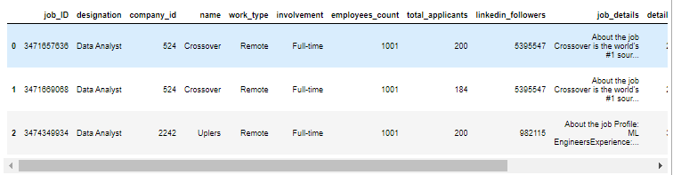
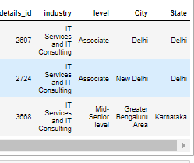
5. CREATING NEW COLUMNS
1
CREATING A CATEGOGY_ID AND DETAILS_ID COLUMNS
We Create A Category_id And Details_id Columns In The Data Frame For Mapping All Three Tables

Slide 19
VISUAL ANALYTICS AND FINDINGS
5

Slide 20
SUMMARY OF DATA
Total number of jobs
Total companies
5587
2321
Total industry
103
There are different jobs available and various companies and industries. The summary below shows the Total summaries.

Slide 21
SUMMARY OF DATA
Total Career Level
Total Involvement field
7
7
Total Job Designation
84
There are various job titles similarly there are various Career level, various fields of job and various job types which is been shown below.

Slide 22


COMPANY AND DOMAIN WITH HIGHEST NUMBER OF JOBS
EPAM ANYWHERE are the companyy with highest number of Job Titles with 1358 count and 63.9% jobs.
IT SERVICES AND IT CONSULTING is the domain with highest number of jobs, with 482 count and 48.6% different jobs.

Slide 23
TOP 5 COMPANIES AND TOTAL JOBS
RANK | NAME OF THE COMPANIES | TOTAL JOBS
1 | EPAM Anywhere | 1358
2 | Tata Consultancy Services | 238
3 | Uplers | 199
4 | Crossover | 65
5 | Virtusa | 56

Slide 24
CAREER LEVEL
Career level is the type of job work you are going to get according to years of experience you have.
There are seven types of Career Level that are:
Total Career Level
7
1
Entry Level Jobs
Entry level jobs are the job level for fresher's or people entering a new domain.
2
Associate
Associate level jobs are are typically entry-level positions that are one step up from entry-level positions
3
Executive
Middle level jobs are the job level for the people with some years of experience in a particular domain.
4
Mid-Senior
Middle level jobs are the job level for the people with some years of experience in a particular domain.

Slide 25
CAREER LEVEL
Career level is the type of job work you are going to get according to years of experience you have.
There are seven types of Career Level that are:
Total Career Level
7
5
Director
Director level jobs are the job level for senior or people.
2
6
Internship
Internship level for those who are fresher and wanted to get an experience in a field.
7
Not Available
There is Not Available category which means data is not available for that category

Slide 26
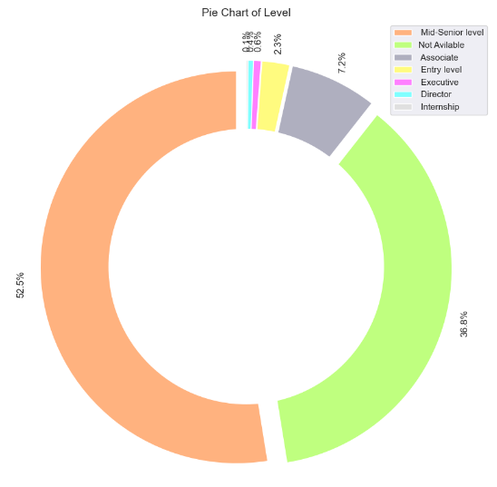
VARIOUS JOB TYPES FOR DIFFERENT JOB TITLES
KEY INSIGHTS
There are various career level according to requirement of the job. Career level depends upon the years of experience of an individual.
Among these categories, Mid-Senior level has the highest share percentage with 52.5%, followed by Not Available with 36.8%, Associate with 7.2%, and Entry level with 2.3%. The remaining categories, 'Director', 'Executive', and 'Internship', are in terms of their share percentage is 1.1%.

Slide 27
VARIOUS JOB TYPES FOR DIFFERENT JOB TITLES
Career Level
Entry Level Jobs
Middle Level Jobs
Senior Level Jobs
Total Entry Level Jobs
Total Middle Level
Jobs
Total Senior Level Jobs
1847
982
382

Slide 28






ENTRY LEVEL JOBS
Company with highest number of Entry Level job is Applicantz, Crossover and IDESLABS PRIVATE LIMITED with 5 Entry Level Jobs.
IT Services and IT Consulting has highest number of Entry Level job, with 42 entry level jobs.
MIDDLE LEVEL JOBS
Company with highest number of Middle Level job is EPAM Anywhere, with 1358 Middle Level Jobs.
IT Services and IT Consulting has highest number of Middle Level job, with 2190 Middle level jobs.
ASSOCIATE LEVEL JOBS
Company with highest number of Senior Level job is. Tata Consultancy Services, with 85 Senior Level Jobs.
IT Services and IT Consulting has highest number of Senior Level job, with 196 Senior level jobs.

Slide 29
EXECUTIVE LEVEL JOBS
Company with highest number of Executive job is Genpact with 3 Entry Level Jobs.
IT Services and IT Consulting has highest number of Entry Level job, with 42 entry level jobs.
DIRECTOR LEVEL JOBS
Company with highest number of Middle Level job is Crossover with 4 Middle Level Jobs.
IT Services and IT Consulting has highest number of Middle Level job, with 2190 Middle level jobs.
INTERNSHIP LEVEL JOBS
Company with highest number of Senior Level job is Techolution , with 2 Senior Level Jobs.
IT Services and IT Consulting has highest number of Senior Level job, with 6 Senior level jobs.

Slide 30
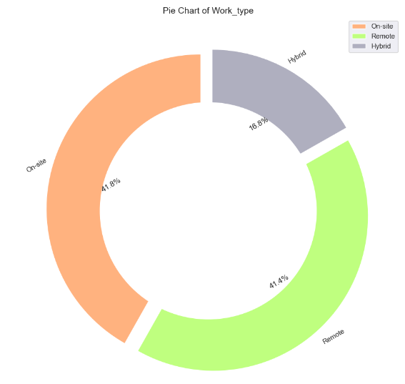
TYPE OF WORK
KEY INSIGHTS
There are 3 type of work_type according to requirement of the job On-site, Hybrid and Remote
Among these categories, On-site has the highest share percentage with 48.1%, followed by Remote with 41.4%, Hybrid with 18.8%.

Slide 31
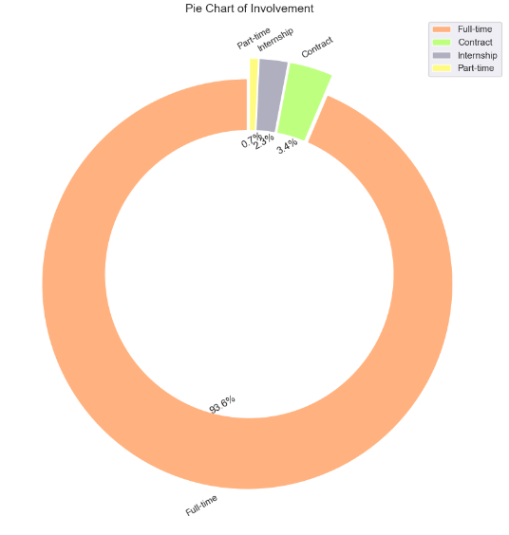
VARIOUS JOBS COUNT FOR DIFFERENT TYPE OF INVOLVEMENT
KEY INSIGHTS
There are 4 type of Involvement according to requirement of the job Full-time, Contract, Internship and Part-Time
Among these categories, Full-Time has the highest share percentage with 93.6%, followed by Contract with 3.4%, Internship with 2.3% and Part-Time with 0.7%

Slide 32
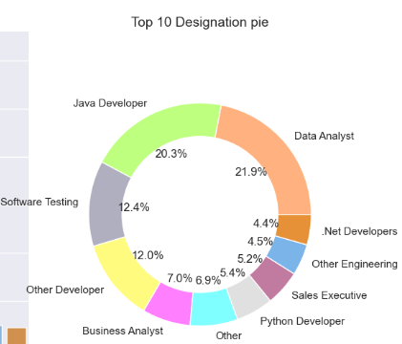
TOP 10 DESIGNATION COUNT
KEY INSIGHTS
Among the top 10 designation categories, Data Analyst has the highest percentage with 21.9% within the top 10 categories and 12.93% overall. On the second position is Java Developer with 20.3% within the top 10 categories and 11.97% overall.

Slide 33
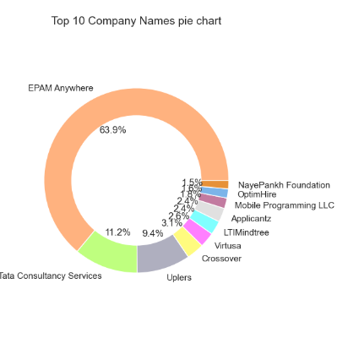
TOP 10 COMPANIES PROVIDING THE MOST NUMBERS OF JOBS
KEY INSIGHTS
In the Name column, which represents the company name, there is a high number of unique categories. To analyze this column, we checked the frequency distribution and identified the top 10 company names.
Among the top 10 company names, the highest number of jobs is offered by Epam Anywhere with a percentage of 63.9% within the top 10 categories and 24.30% overall.

Slide 34
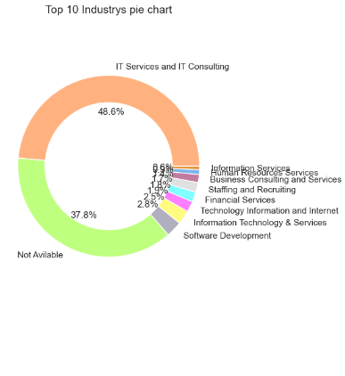
TOP 10 INDUSTRIES PROVIDING THE MOST NUMBERS OF JOBS
KEY INSIGHTS
In the Industry' column, which represents the industry name, there is a high number of unique categories. To analyze this column, we checked the frequency distribution and identified the top 10 industry names.
Among the top 10 industry names, the highest percentage of jobs is in the IT Services and IT Consulting industry. It accounts for 48.6% within the top 10 categories and 44.71% overall..

Slide 35
TOP 10 INDUSTRIES PROVIDING THE MOST NUMBERS OF JOBS
KEY INSIGHTS
In the Industry' column, which represents the industry name, there is a high number of unique categories. To analyze this column, we checked the frequency distribution and identified the top 10 industry names.
Among the top 10 industry names, the highest percentage of jobs is in the IT Services and IT Consulting industry. It accounts for 48.6% within the top 10 categories and 44.71% overall..

Slide 36
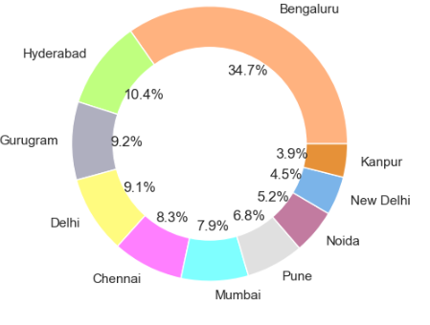
TOP 10 CITYS PROVIDING THE MOST NUMBERS OF JOBS
KEY INSIGHTS
In the City column, which represents the City names, there is a high number of unique categories. To analyze this column, we checked the frequency distribution and identified the top 10 city names.
Among the top 10 city names, the highest number of jobs is from the city of Bangalore, with a percentage of 34.7% within the top 10 cities and 25.07% overall.

Slide 37
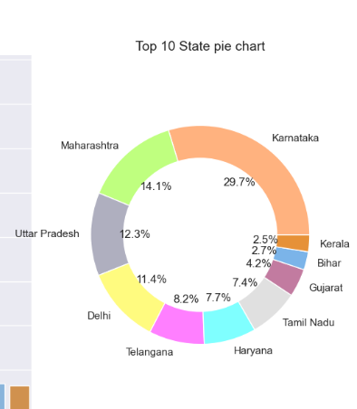
TOP 10 STATE PROVIDING THE MOST NUMBERS OF JOBS
KEY INSIGHTS
In the State column, which represents the State names, there is a high number of unique categories. To analyze this column, we checked the frequency distribution and identified the top 10 State names.
Among the top 10 State names, the highest number of jobs is from the State of Karnataka, with a percentage of 29.7% within the top 10 cities and 27.65% overall.

Slide 38
JOB ROLES LEVEL
Total Analytics field
There are Seven types of Career Level that are:
7
1
Data Analyst Jobs
2
Business Analyst Jobs
Analyst
3
AI Engineer
4
Power BI Developer
5
6
Data Scientist
Quality Analyst
7

Slide 39
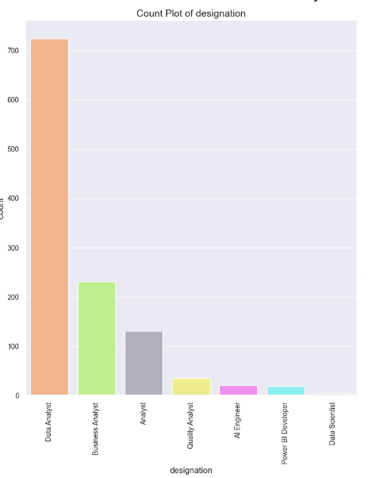
JOBS ACROSS VARIOUS ANALYTICS FIELDS
Data Analyst
724
Business Analyst
231
Analyst
131
Quality Analyst
35
AI Engineer
27
Power BI Developer
19
Data Scientist
5
KEY INSIGHTS
According to the analysis, the data analyst role has the highest job count, with over 700 positions, making up 62.1% of the job share within the Analytics field. Following closely is the business analyst role, with over 200 positions, representing 19.8% of the job share. These findings indicate a strong demand for professionals in both data and business analytics, highlighting the significance of these roles in the job market.

Slide 40





COMPANY WISE INSIGHTS
As per below table and chart, TCS Company provides the most number of jobs in the analytics field, mostly in the data analyst position.
Applicantz provides the highest number of jobs in the field of Power BI Developer.
The companies Integrated Personnel Services Limited, Jobs for Humanity, Rayden Interactive, and WNS offer the most number of jobs in the Analyst role.
TCS has the most number of job openings for Business Analyst positions.
TJX Global IT - India and Uplers offer the highest number of jobs in the Quality Analyst position.
Uplers provides the most number of jobs for AI Engineer positions.
The companies Align Technology, Avataar, Continental, Spyne, and Stealth Startup offer the most number of jobs in the field of Data Scientist.

Slide 41
DOMAIN WISE INSIGHTS
IT Services and IT Consulting domain is the highest which has 2500 job opening in data science job
role.
Human Resources/Consultancy domain is the highest which has 137 job opening in data analyst job role.
Information Technology domain is the highest which has 17 job opening in data engineer job role.
Information Technology domain is the highest which has 9 job opening in machine learning engineer role.
Human Resources/Consultancy domain is the highest which has 22 job opening in business intelligence role.

Slide 42
ENTRY LEVEL WISE INSIGHTS
Data Scientist has 1033 entry level jobs.
Data Analyst has 214 entry level jobs
Data Engineering has 22 entry level jobs
Machine Learning Engineering has 8 entry level jobs.
Business Intelligence has 51 entry level jobs.

Slide 43
MIDDLE LEVEL WISE INSIGHTS
Data Scientist has 785 middle level jobs.
Data Analyst has 147 middle level jobs. Data Engineering has 18 middle level jobs.
Machine Learning Engineering has 12 middle level jobs.
Business Intelligence has 38 middle level jobs.

Slide 44
SENIOR LEVEL WISE INSIGHTS
Data Scientist has 672 senior level jobs.
Data Analyst has 141 senior level jobs.
Business Intelligence has 48 senior level jobs, followed by Data Engineer having 15 and
Machine Learning Engineer having 7 jobs respectively.

Slide 45
KEY INSIGHTS
6

Slide 46
INSIGHTS TO BE FOUND?
1
There are 3211 jobs available for Data Science & 1547 for UI/UX.
1223 & 692 companies are providing jobs for Data Science & UI/UX respectively.
There are around 51 & 46 different domains in which jobs are provided for DS & UI/UX respectively
HKT and Michael Page are the companies which has
highest job opening.
Human Resources Management/Consulting is the domain which has on an average highest number of jobs.
2
3
4
5

Slide 47
INSIGHTS TO BE FOUND?
6
Entry level jobs has the highest openings.
Data Science has highest job titles followed by Data
analyst.
7
8
ML Engineer has the least job titles.
Most companies prefer individuals with degree for their job roles
9
10
Most job types are temporary contract based.

Slide 48
DASHBOARD
7

Slide 49
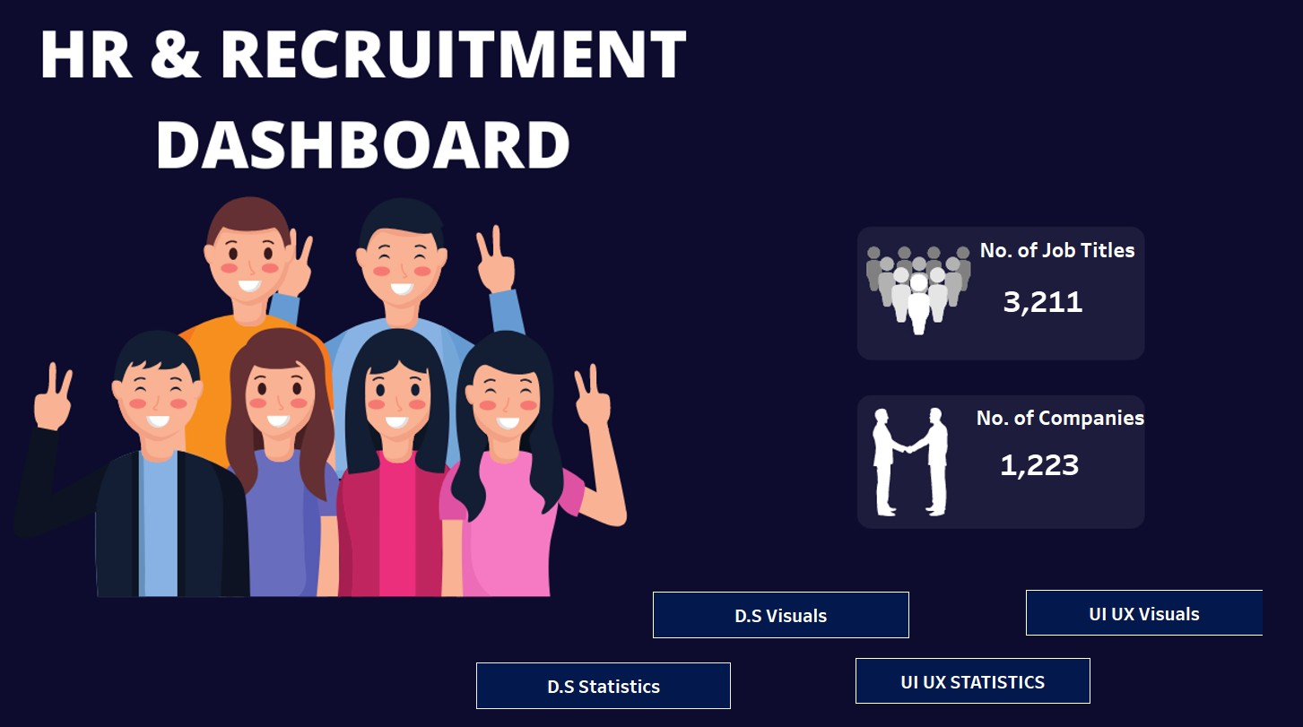
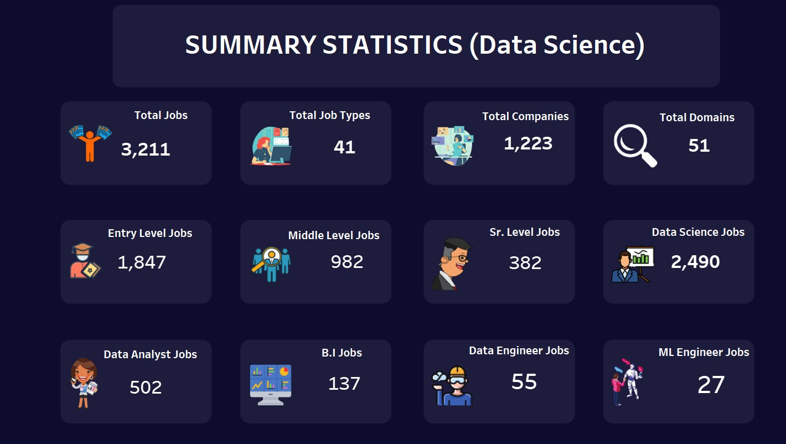
DASHBOARD PAGES VIEW
HOME PAGE OF THE DASHBOARD
SUMMARY STATISTICS PAGE

Slide 50

THANK/ YOU !
PRESENTATION BY: Jay Charole

